Slide 1
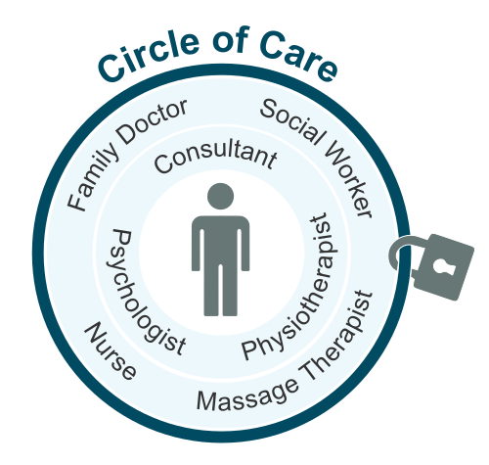
SECURE social share
Notes:
Image Source : https://images.app.goo.gl/Gf7zYAkGsaFeUFmR9

Slide 2
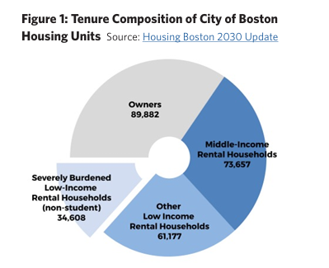
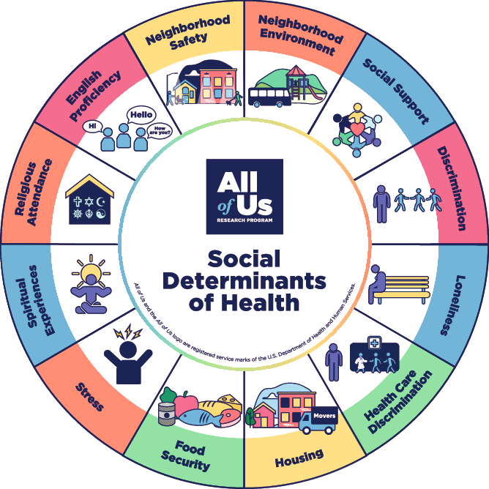
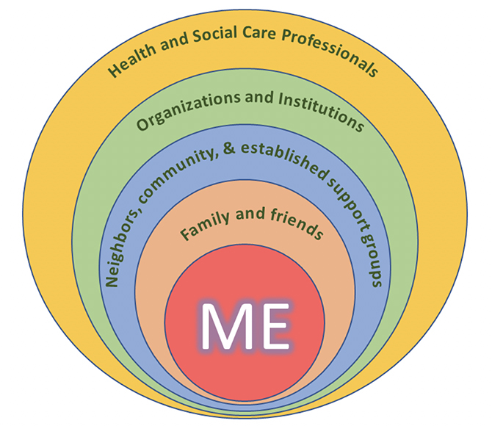
BIG CITY ISSUES : CURRENT BOSTON SOCIAL ISSUES
Boston is experiencing
an immediate housing crisis,
transportation issues,
opioid problems
IT HAS WIDER IMPLICATIONS TO
PERSONAL DATA SHARE

Slide 3
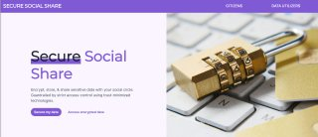
BALANCED USABILITY And data protection compliance for @scale social adoption
Web 2
(shortcomings)
Web3
(shortcomings)
Centralized
Lack of Transparency
Points of attack
Unusable UI
Patterns focused on Finance
Adoption barriers

Slide 4
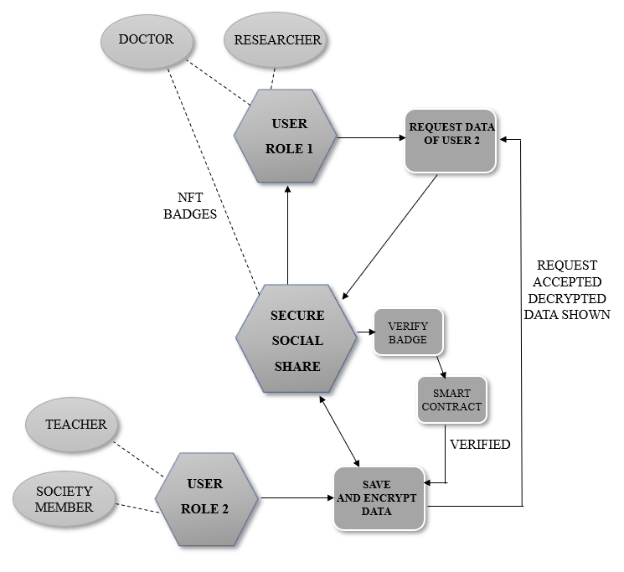
Flowchart
A web2-like experience to hold multiple inter-related types of DIGITAL ASSETS to be shared with participants of the societal network
The participants in the network are designated by BADGES(the app gives a configurable way to set the badges example: social worker, researcher, etc.)
A decentralized way of ENCRYPTING DATA, and SHARING DATA only to qualified custodians set by configurable rule settings
Way to reduce cost for participants in the network for increased adoption

